Slide 1


Slide 2
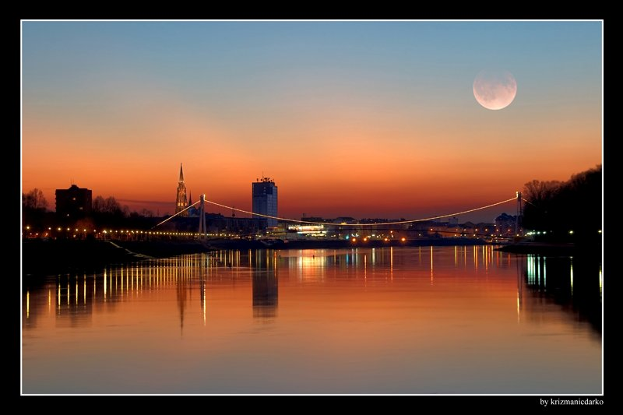
OSIJEK
fourth largest city in Croatia (about 110,000 inhabitants)
located in Eastern Croatia
most verdant city in the Republic of Croatia
city of extraordinary cultural, historical, and also gastronomical heritage
some of the numerous interesting sites to be visited:

Slide 3
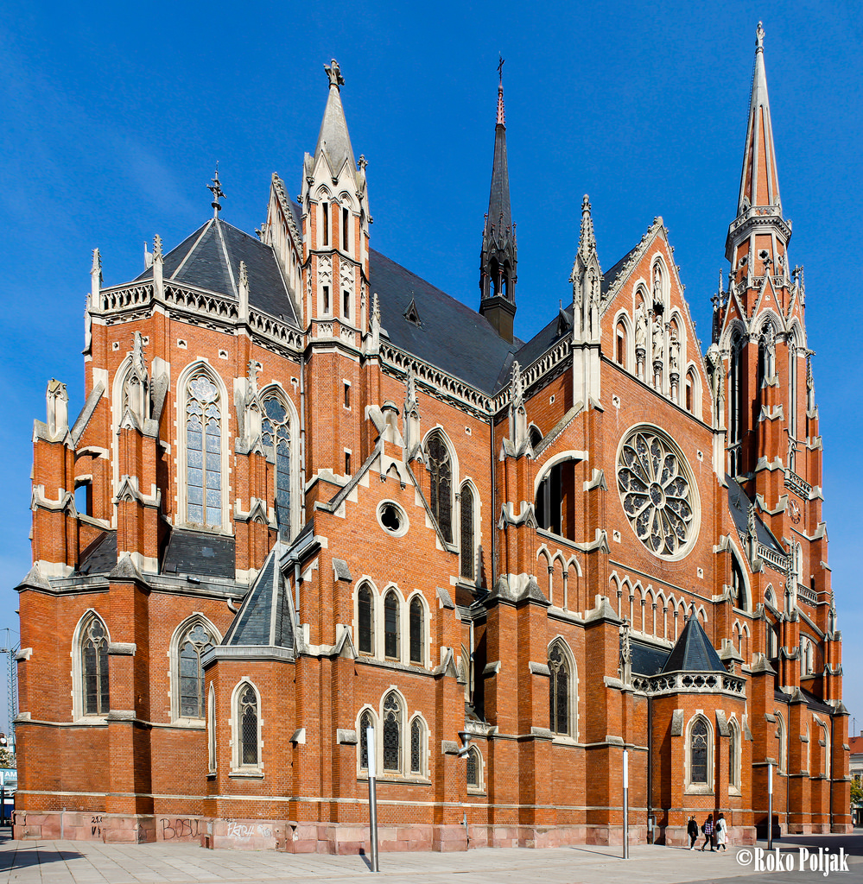
→ Perish of Holy Peter and Paul (co-cathedral)

Slide 4
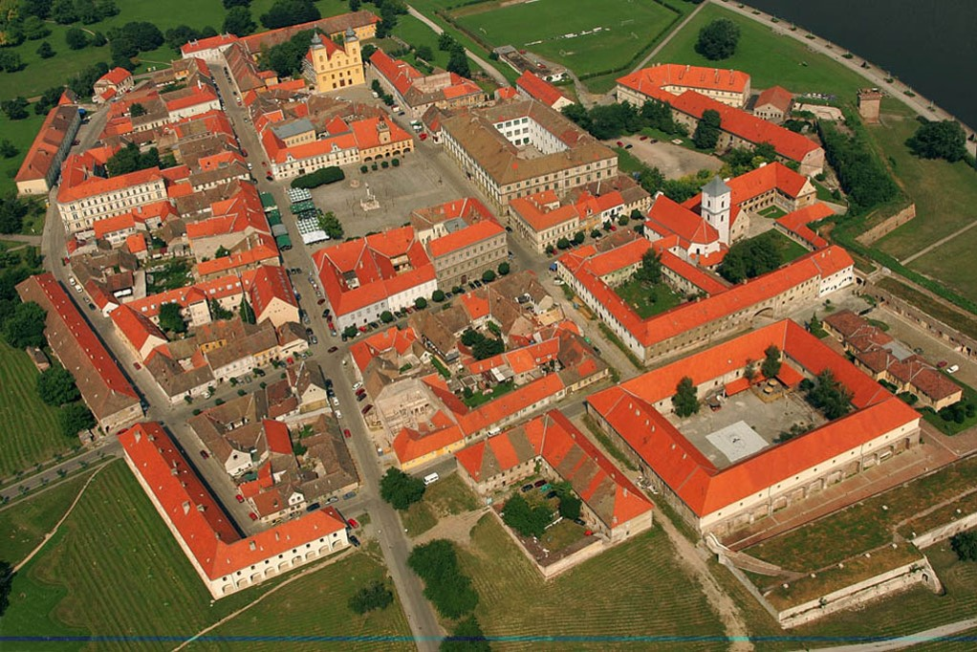
→ Baroque Tvrđa

Slide 5
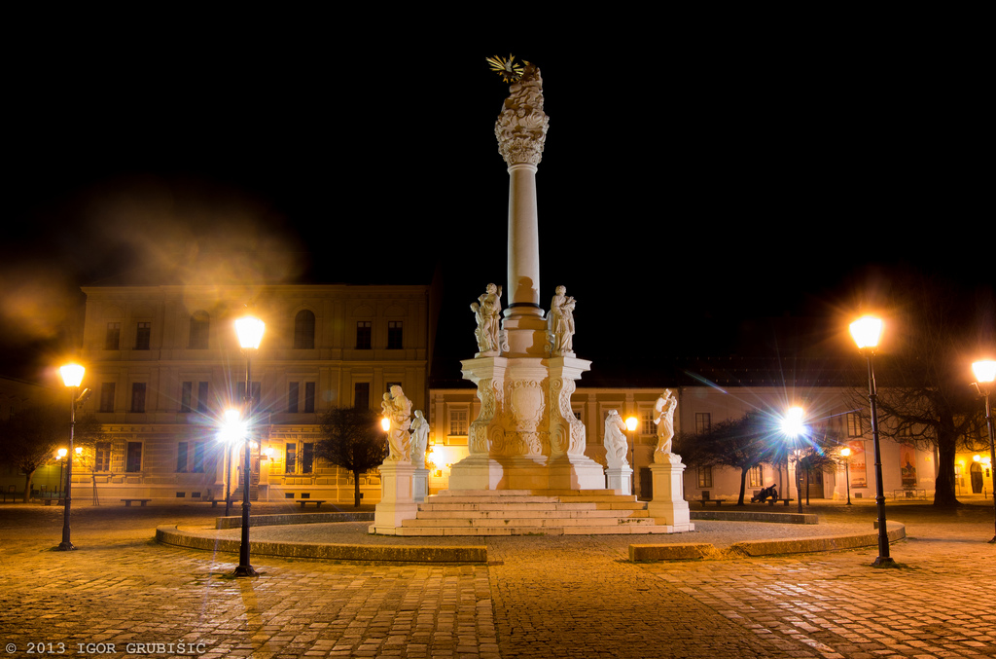
→ the Holy Trinity Square

Slide 6
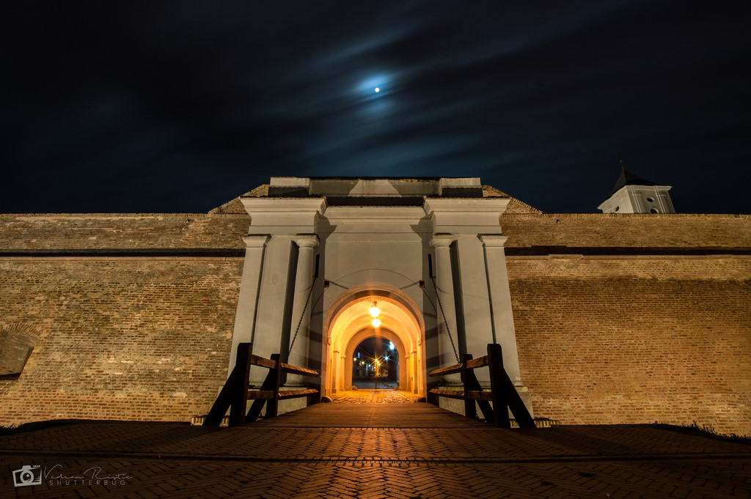
→ Water Gate

Slide 7
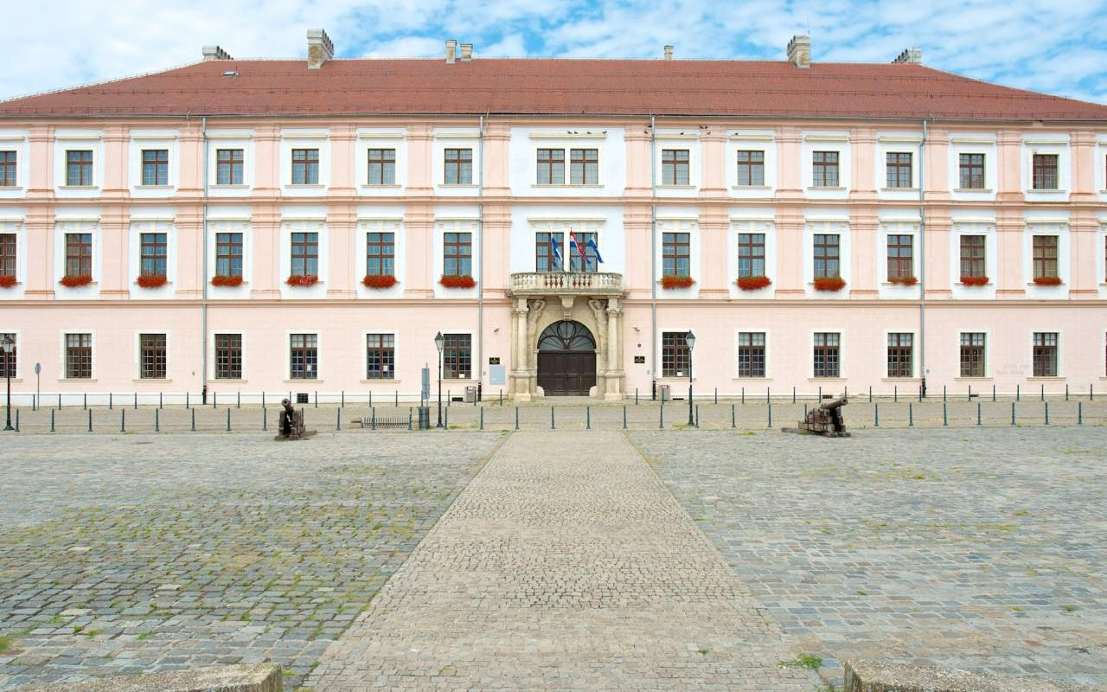

JOSIP JURAJ STROSSMAYER UNIVERSITY OF OSIJEK
established in 1975.
+1,400 employees, about 20,000 students (almost 2,000 at FERIT)
17 constituent units:
    11 faculties
    5 University departments
    1 Academy of Arts
    3 university infrastructure institutions
    → University Library in Osijek
    → Student Centre in Osijek and Slavonski Brod
    → Techology Development Centre Osijek Ltd.

Slide 8




Faculty of Electrical Engineering, Computer Science and Information Technology Osijek
About FERIT

Slide 9
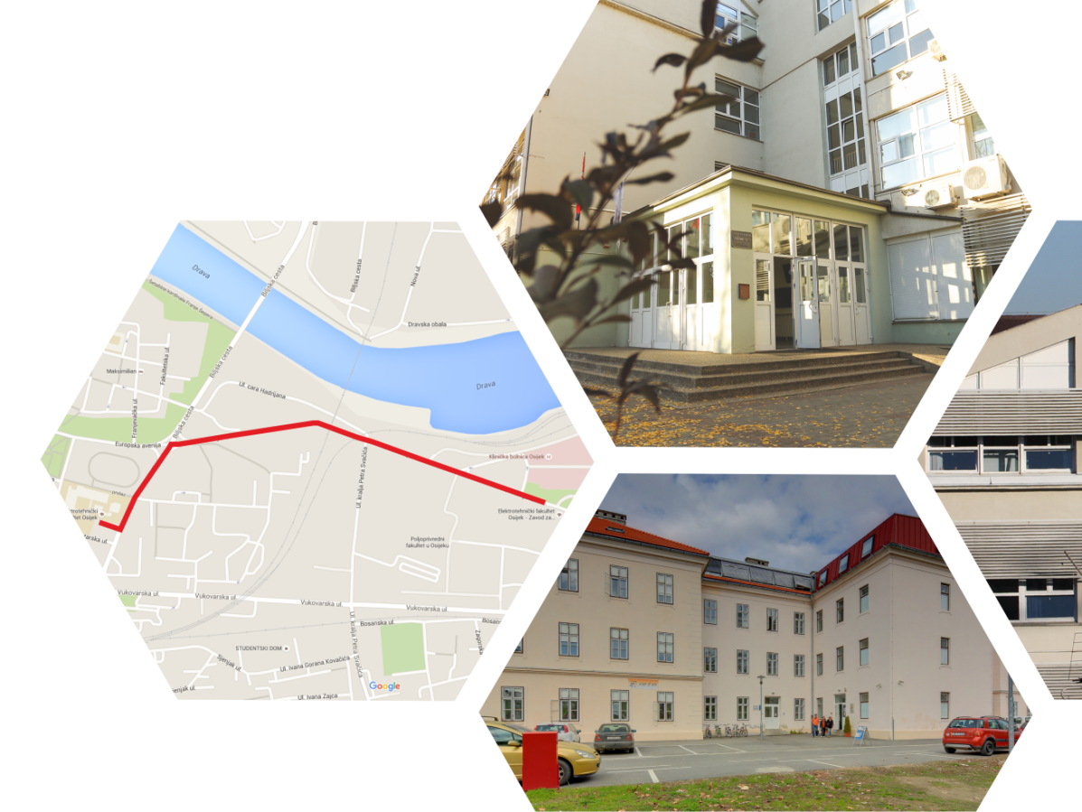
Faculty of Electrical Engineering, Computer Science and Information Technology Osijek
About FERIT
established 1978
today:
- 2 buildings (about 9000 sqm.)
- 6 departments
- 27 laboratories
- about 2,000 students
- about 150 employees
- about 90 researchers
Dr. DRAGO ŽAGAR
Full Professor with Tenure
Dean, RESCUE team member

Slide 10



DEPARTMENT OF CORE COURSES
DEPARTMENT OF COMMUNICATIONS
DEPARTMENT OF SOFTWARE ENGINEERING
- Chair of Mathematics and Physics
Chair of Radiocommunications and Telecommunications
Prof Žagar, Dr Vranješ RESCUE FERIT IT&A, BEMS
- Chair of Visual Computing
- Chair of Mechanical Engineering and Foreign Languages
Chair of Programming Languages and Systems
Dario Došen, Mcomp
RESCUE FERIT IT&A, BEMS
- Chair of Electronics and Microelectronics
- Laboratory for High Frequency Measurements

Slide 11



DEPARTMENT OF POWER ENGINEERING
Chair of Power Systems and Substations
Prof Marić, Prof Knežević, Prof Fekete, Kljajić MEng
DEPARTMENT OF COMPUTER ENGINEERING AND AUTOMATION
DEPARTMENT OF ELECTROMECHANICAL ENGINEERING
Chair of Power Plants and Energy Processes
Prof Šljivac (head), Prof Topić, Žnidarec MEng
- Chair of Automation and Robotics
- Chair of Fundamentals of Electrical Engineering and Measurements
- Chair of Computer Engineering
Prof Keser
FERIT RESCUE IT&A, BEMS
Electromagnetic Compatibility Laboratory
Prof Klaić (vice), Primorac MEng
FERIT RESCUE RESe, BEMS
Chair of Electric Machines and Power Electronics
Prof Pelin, Brandis MEng
FERIT RESCUE PE, BEMS

Slide 12
Study programmes
Postgraduate specialist study programme in Electric Power Networks in the Market Environment
Postgraduate doctoral study programme in Electrical Engineering
Postgraduate specialist study programme in
Advanced Communication Technologies
Postgraduate specialist study programme in Process Computing
Graduate university SP in Computer Eng
Computer Eng
Software Eng
Robotics & AI
Inf & data science
Graduate university study programme
Communication&IT (ICT)
Network tech
Comm tech
Graduate university study programme in
Power Engineering (PE)
Power Systems,
Sustainable PE
Industrial PE
Graduate university study programme in
Automotive computing
and communications
Differential coursework
Undergraduate university study programme
in Computer Engineering
Undergraduate university study programme in Electrical Engineering and Information Technology
Professional study programme in Electrical Engineering
Professional study programme in Computing

Slide 13
RESEARCH GROUPS
RESEARCH GROUP FOR INTELLIGENT SYSTEMS AND ROBOTICS
RESEARCH GROUP FOR COMPUTER SCIENCE AND HUMAN-COMPUTER INTERACTION
RESEARCH GROUP FOR ADVANCED (SMART) ENERGY TECHNOLOGIES AND SYSTEMS
Šljivac, Klaić, Marić, Topić, Knežević, Fekete, Kljajić, Žnidarec, Primorac
RESEARCH GROUP FOR HIGH-PERFORMANCE COMPUTING AND DATA ANALYSIS
Došen
RESEARCH GROUP FOR ADVANCED INDUSTRIAL SYSTEMS
Pelin, Brandis
RESEARCH GROUP FOR
COMPUTER ENGINEERING
Keser
RESEARCH GROUP FOR INFORMATION AND COMMUNICATION TECHNOLOGIES
Žagar, Vranješ
RESEARCH GROUP FOR
BIOMEDICAL ENGINEERING
RESEARCH GROUP FOR ADVANCED TEACHING METHODS IN TECHNICAL SCIENCES
RESEARCH GROUP
FOR INTELLIGENT VEHICLES

Slide 14
FERIT Laboratory for Renewable Energy Sources
http://reslab.ferit.hr/
RESEARCH GROUP FOR ADVANCED (SMART) ENERGY TECHNOLOGIES AND SYSTEMS and DEPARTMENT FOR POWER ENGINEERING, head: Šljivac
Established in 2014 within IPA CBC Croatia Hungary REGPHOSYS project, head Pelin (2013-2014), partners: FERIT, Hungarian Academy of0 Sciences, Kaposvar Univeristy - 10 kW power plant ETFOS1 (FERIT1) and 5 different PV techologies testing (REGPHOSYS)
On-line research measurements data-base (FERIT internal research project)
Interreg CBC Croatia Hungary RuRES project (2017-2018), head Topić, partners: FERIT, Hungarian Academy fo Sciences, Kaposvar Univeristy, off-line rural PV system
COST WECANet project (2018-2022), a pan-European network on wave energy convertors and integration with over 30 countries and 50 partners
J.J. Strossmayer Univeristy of Osijek Establishment of RES interdiciplinary research group, partners: FERIT, SFSB (partners of RESCUE team)
Interreg IPA CBC Croatia Serbia RESCUE (2019-2021), partners: FERIT, SFSB, KBCO, FTN, KCV: smart FERIT buildings microgrid development!

Slide 15
FERIT TEAM ROLE ON RESCUE
Establishment of smart FERIT building energy mangement system (BEMS) or microgrid with 120 kW PV power plants on (two) location(s), 20 kW battery storage system, 6 kW wind power plant.
Management, sceintific reseach, education/training/workshops (OS, SB, NS, SU), disemination, etc.
PV power plant FERIT 1 (80 kW)
(Trpimirova street building)
PV power plant FERIT 2 (40 kW)
(University Campus building)

Slide 16
FERIT TEAM ROLE ON RESCUE
Technical support for smart KBCO building energy management system (microgrid) with 230 kW power plants on two locations, 2x125 kW biodiesel generators
PV power plant KBCO 1 (110 KW)
(Nutririon building)
PV power plant KBCO 2 (120 kW)
(Oncology and Radiology buildings)

Slide 17

FERIT Office for International Cooperation, Scientific and Research Projects​
Mirela Glavaš, head, mirela.glavas@ferit.hr
Tihana Vajnand (RESCUE) administrative staff, tihana.vajnand@ferit.hr
establishes and supports international cooperation of the Faculty at the institutional level;
informs and educates staff and students about the possibilities of participation in international initiatives, research and educational programmes/projects and mobility programmes;
prepares, monitors and provides support in implementation of international, scientific and research projects;
manages outgoing and incoming mobility procedures for students, academic and non-academic staff.
Active Cooperation with about 60 institutions: Albania, Austria, Bulgaria, Bosnia and Herzegovina,France, Germany, Hungary,
Italy, Latvia, Macedonia, Montenegro, Poland, Portugal, Romania,
Serbia (incl. FTN Novi Sad),
Slovakia, Slovenia, Spain, Sweden, Switzerland, The Netherlands, Turkey, USA

